Slide 1
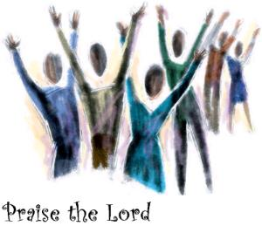
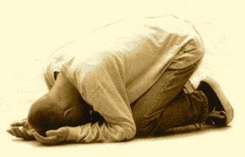
προσκυνέω = “I Worship”
?

Slide 2
Psalm 33.1 NET: You godly ones, shout for joy because of the LORD! It is appropriate for the morally upright to offer him praise.
Psalm 66.1-2 NIV: Shout for joy to God, all the earth! Sing the glory of his name; make his praise glorious.

Slide 3
Matthew 22.37-38 NET: Jesus said … “‘Love the Lord your God with all your heart, with all your soul, and with all your mind.’ This is the first and greatest commandment.”

Slide 4
Acts 11.23 NET: When [Barnabas] came and saw the grace of God [among the Gentiles of Antioch], he rejoiced and encouraged them all to remain true to the Lord with devoted hearts…

Slide 5
Psalm 55.22 NASB: Cast your burden upon the LORD and He will sustain you; He will never allow the righteous to be shaken.
Jeremiah 17.7 NLT: But blessed are those who trust in the LORD and have made the LORD their hope and confidence.”
Ephesians 6.10-11 NIV: Finally, be strong in the Lord and in his mighty power. Put on the full armor of God, so that you can take your stand against the devil's schemes.

Slide 6
James 4.6b-7a NLT: As the Scriptures say, “God opposes the proud but favors the humble.” So humble yourselves before God.
Luke 11.28 NET:
Jesus said, “Blessed …
are those who hear the word of God and obey it!”
John 14.15 NET: Jesus said, “If you love me, you will obey my commandments.”

Slide 7
Luke 4.8 NIV: [Jesus said] “It is written: ‘Worship the Lord your God and serve him only.’”
John 4.23 NLT: [Jesus said] “But the time is coming-- indeed it's here now-- when true worshipers will worship the Father in spirit and in truth. The Father is looking for those who will worship him that way.”
“worship” translates προσκυνέω

Slide 8
When we say “I Worship”
but προσκυνέω
we think
includes

Slide 9
Matthew 2.11a NET: As they [the three wise men] came into the house and saw the child with Mary his mother, they bowed down and worshiped him.
προσκυνέω

Slide 10
Matthew 8.2 NASB: And a leper came to Him [Jesus] and bowed down before Him, and said, “Lord, if You are willing, You can make me clean.”
προσκυνέω

Slide 11
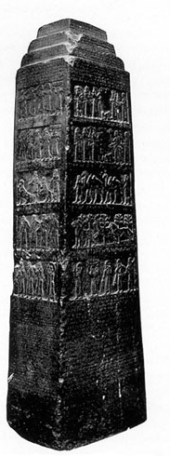
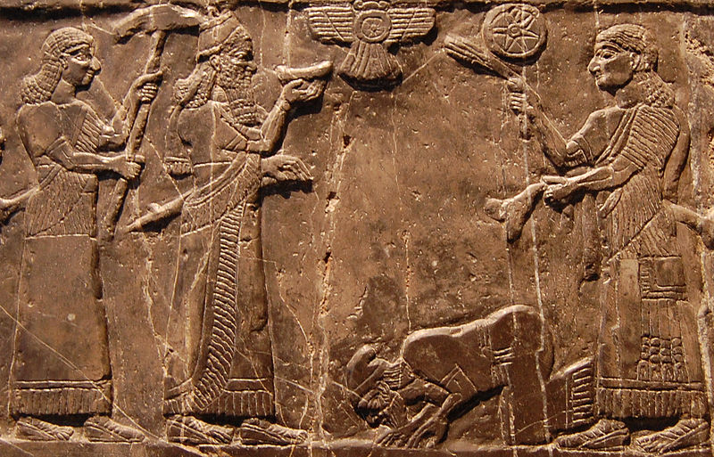
Images courtesy of bible-history.com and wikipedia.org

Slide 12
Matthew 9.18 NIV: While he [Jesus] was saying this, a synagogue leader came and knelt before him and said, “My daughter has just died. But come and put your hand on her, and she will live.”
προσκυνέω

Slide 13
When we say “I Worship”
but προσκυνέω
we think
includes

